Slide 1
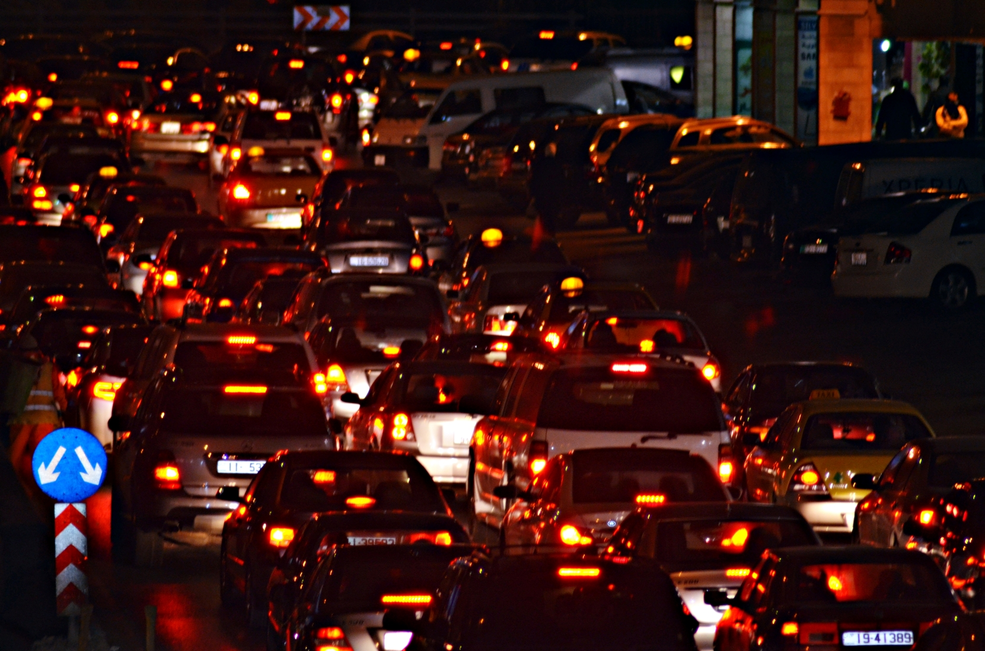

Virtual Eye
JUST SEE AND RETRIVE
Ideologist:
Aitik Dandapat
Rittik Biswal
Akhtar Rajja Khan
Akash Pattanayak
This Photo by Unknown Author is licensed under CC BY-SA

Slide 2

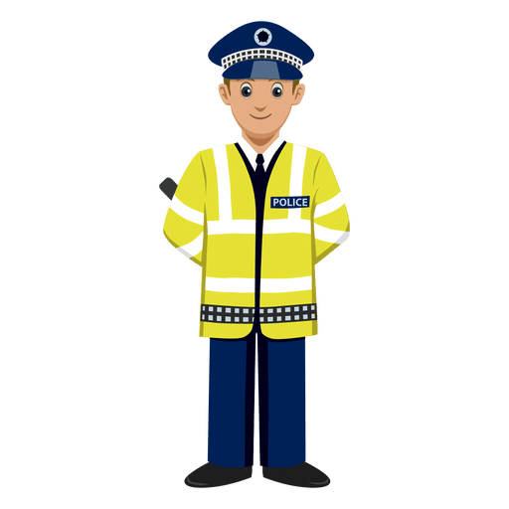

What is the Problem?
Approach to the Problem.
“Virtual Eye” as a social model
Features of the “Virtual EYE“.
Snapshots of the web app
Future Enhancements.

Slide 3

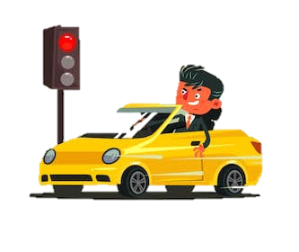
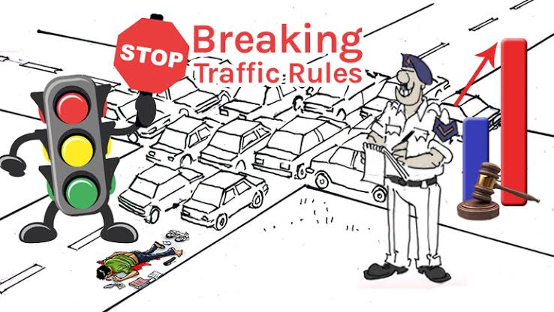
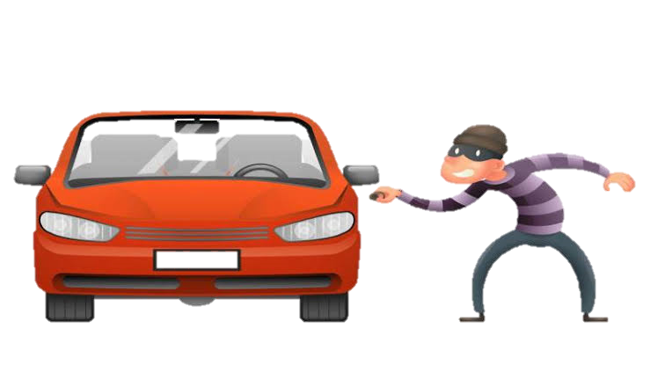
What is the pain or Problem?
“Identification of Vehicles involved in Traffic rule violations and Criminal activities”
The society as a whole is affected by the menace of traffic rule violations. The problem definitely has a tendency to grow because in this era of modernization there is an increase in the number of vehicles on roads which increases the probability of traffic rules violations and other crimes related to the vehicles especially vehicle thievery etc.

Slide 4

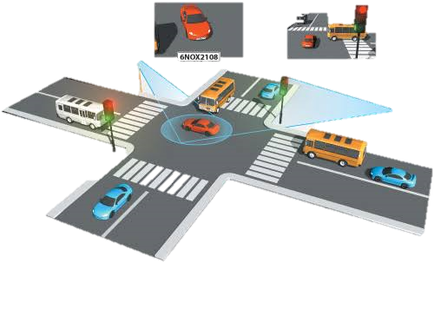
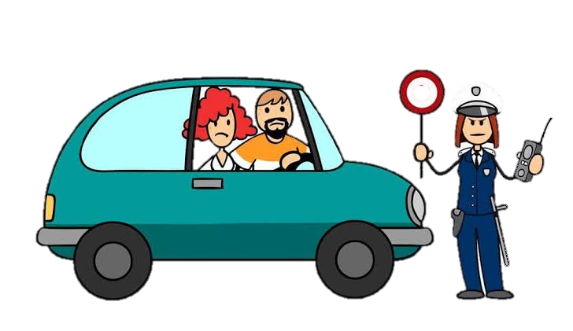
Approach to the problem
We are going to approach this problem by developing a software that will detect the registration Number plates of the vehicles violating the traffic rules and regulations.
we will create a common public database which will be connected to each of the installed CCtv cameras near the traffic signals and roadsides . These cctv cameras will detect the registration number of the vehicles and store it in that database along with the date, time and place.

Slide 5
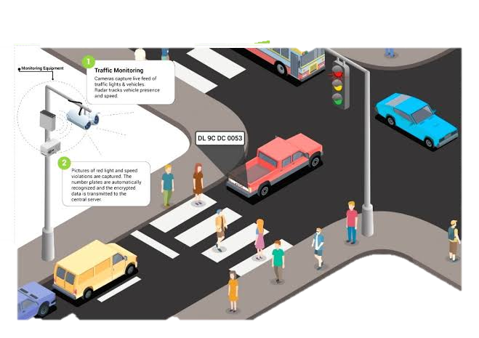
Virtual eye as a social model
In this System , the vehicles involved in traffic rule violations will be stored in public database which will enable in stricter implementation of law . This will ensure that people will follow traffic rules sincerely.
The incidents of Vehicle Thievery will reduce drastically since the stolen vehicles will be recovered very soon and easily through our public database.
It will also help in increasing the general awareness of people about traffic rules and deter people to get involved in traffic rules violations and crimes involving motor vehicles.

Slide 6

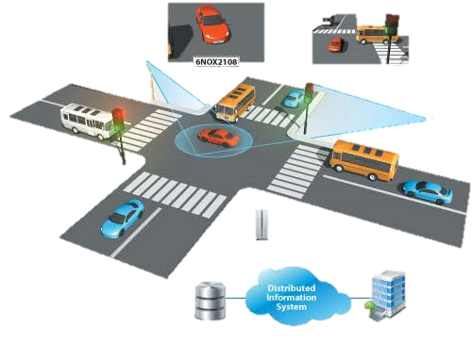




features
development of the software by using python programming language.
The vehicles’ number plates will be detected by the py-tesseract module of the python which is an optical character recognition(ocr) tool which recognizes and reads the character of the number plates.
We have made this software user-friendly by the Development of a web app by using “Flask” which is a micro-web framework written in python.
Implemented sqlite database for storing the registration number of the owner , name of the vehicles etc.

Slide 7
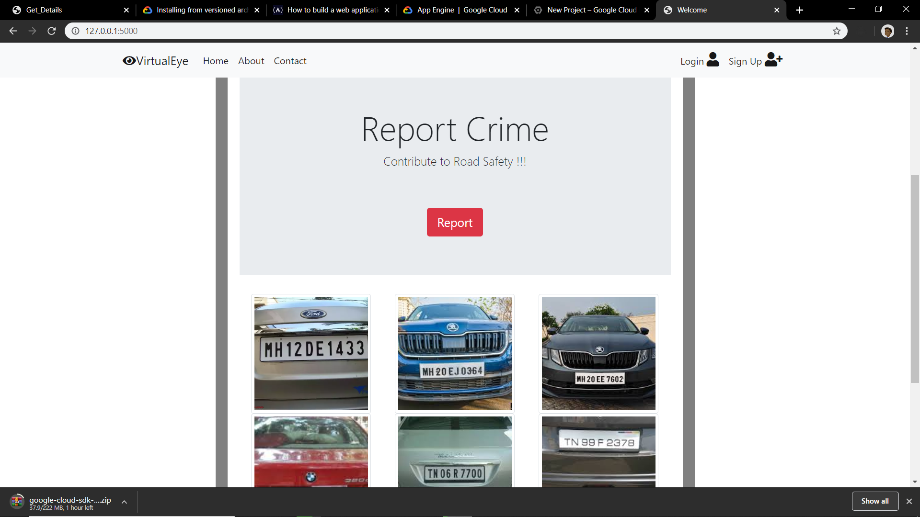
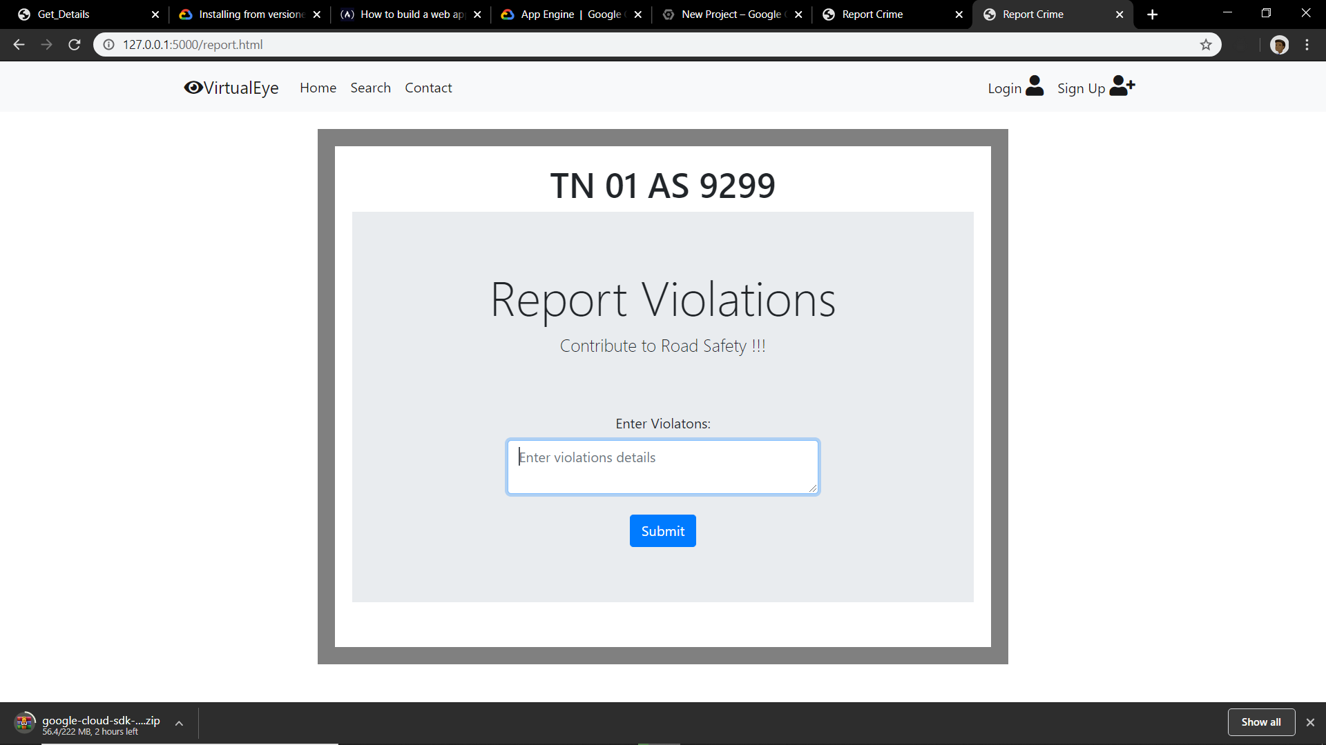
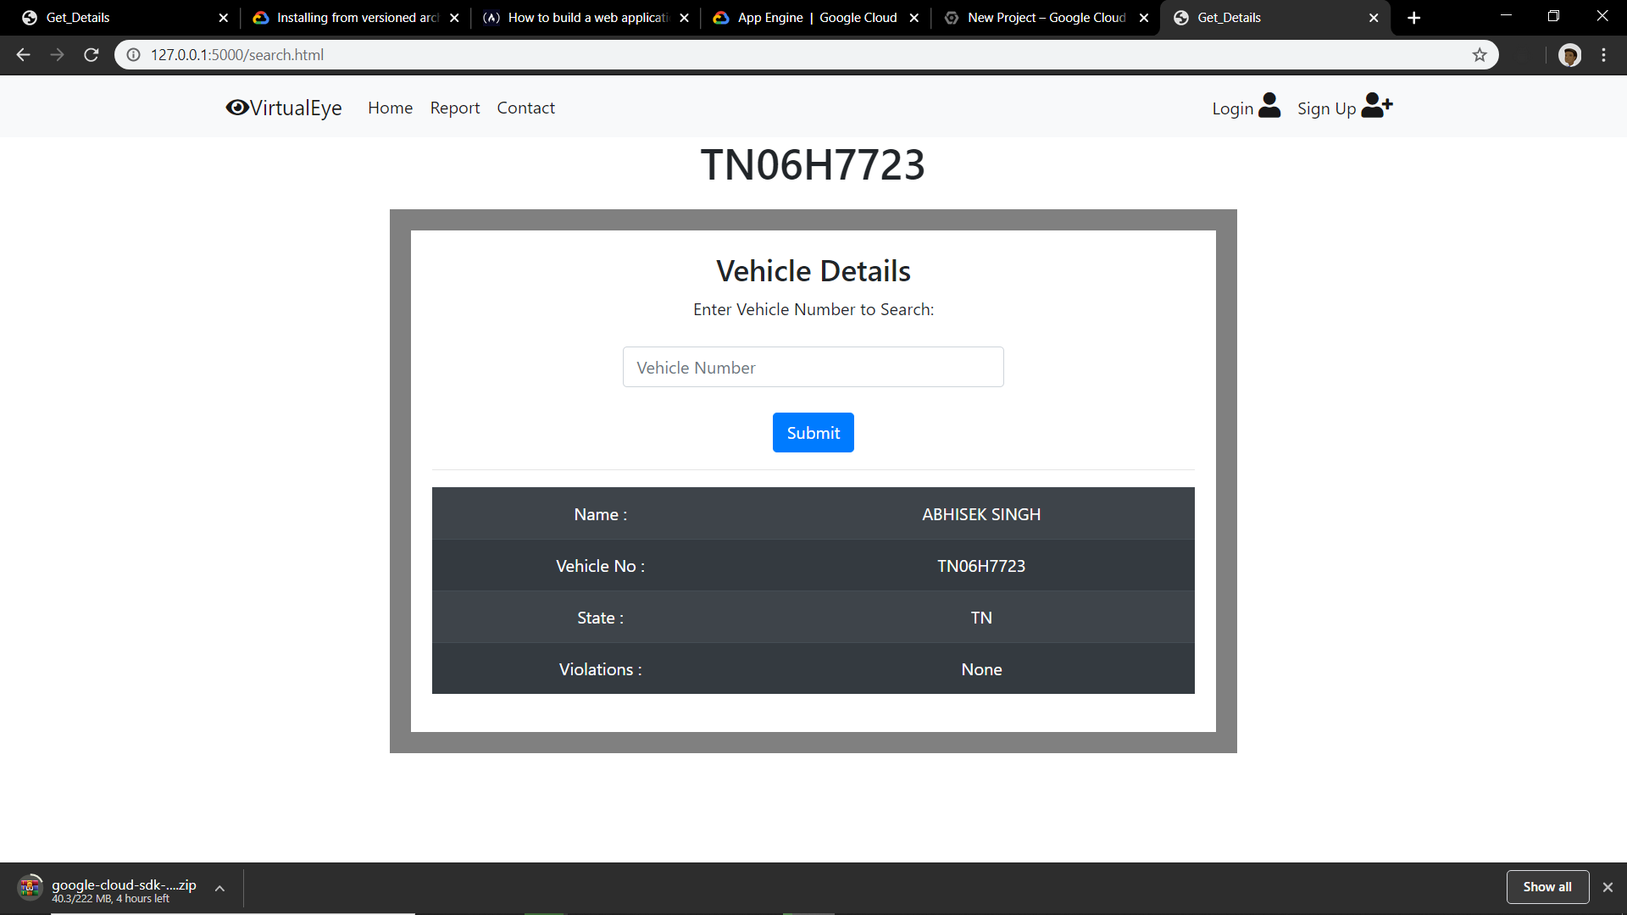
SNAPSHOTS OF OUR WEB APPLICATION:

Slide 8
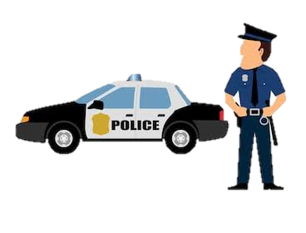
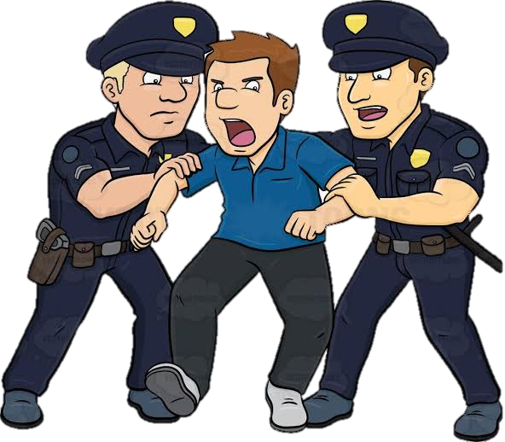

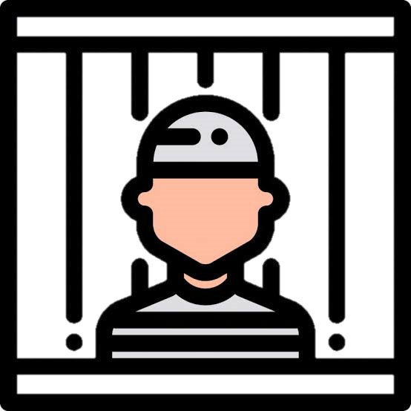
Future enhancements
We are thinking of using this “virtual eye” software for the monitoring of the pcr vans in the cities.
We can fix this software installed cameras in the police vans so that while chasing an another vehicle ,we can continuously track the necessary details of the suspects’ vehicles’
In future, further we can use machine learning and Artificial intelligence for better accuracy in the detection of the vehicles ,traffic signals, and traffic signs which is an essential contribution towards the development of self driving car.

Slide 9
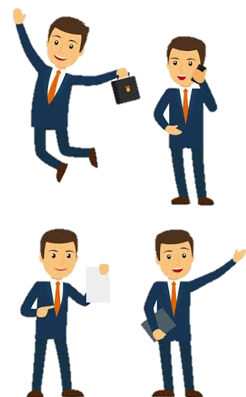
Thank you!!

